Slide 1

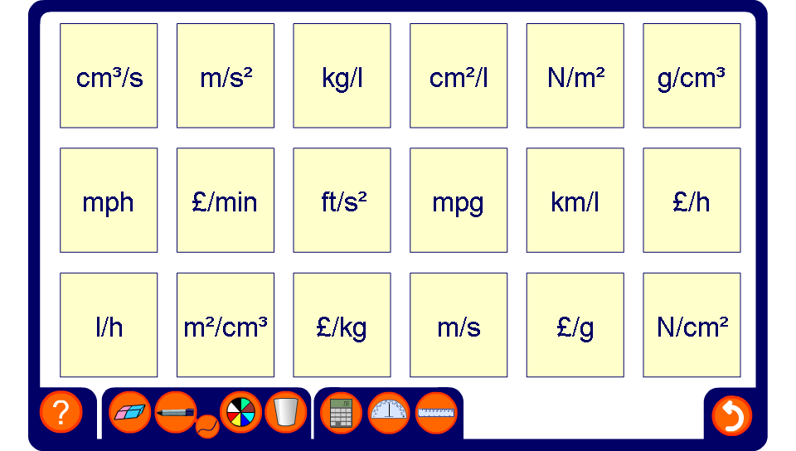


Pairs – compound measures
Notes:
Ask pupils to come to the board and choose two cards that show units that can be used to measure the same rate. Ask them to tell you what the matching unit could be used to measure. For example, m²/cm³ and cm²/ml could be used to measure the amount of surface covered per unit volume of paint.
Some of the units shown may by less familiar such as m/s² and ft/s² for measuring acceleration. Another way of expressing this unit is m/s/s or ft/s/s.
Point out that when there is a ‘p’ instead of a ‘/’ we are usually referring to imperial units. For example, mph for miles per hour or mpg for miles per gallon.
Also point out that volume can be measured in cm³, m³ or in litres, l.

